Slide 1
Effect on Library Size on Protein Identification and Quantification: TimsTOF
Advanced Clinical Biosystems Research Institute
Qin Fu
Niveda Sundararaman

Slide 2
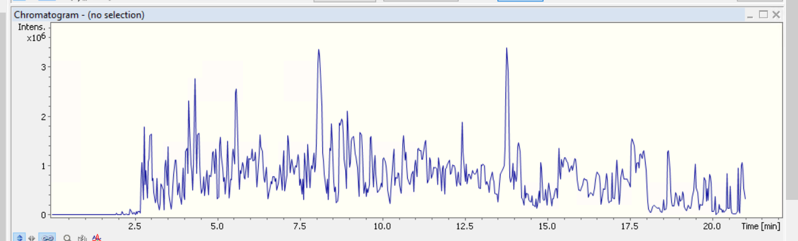
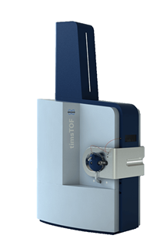
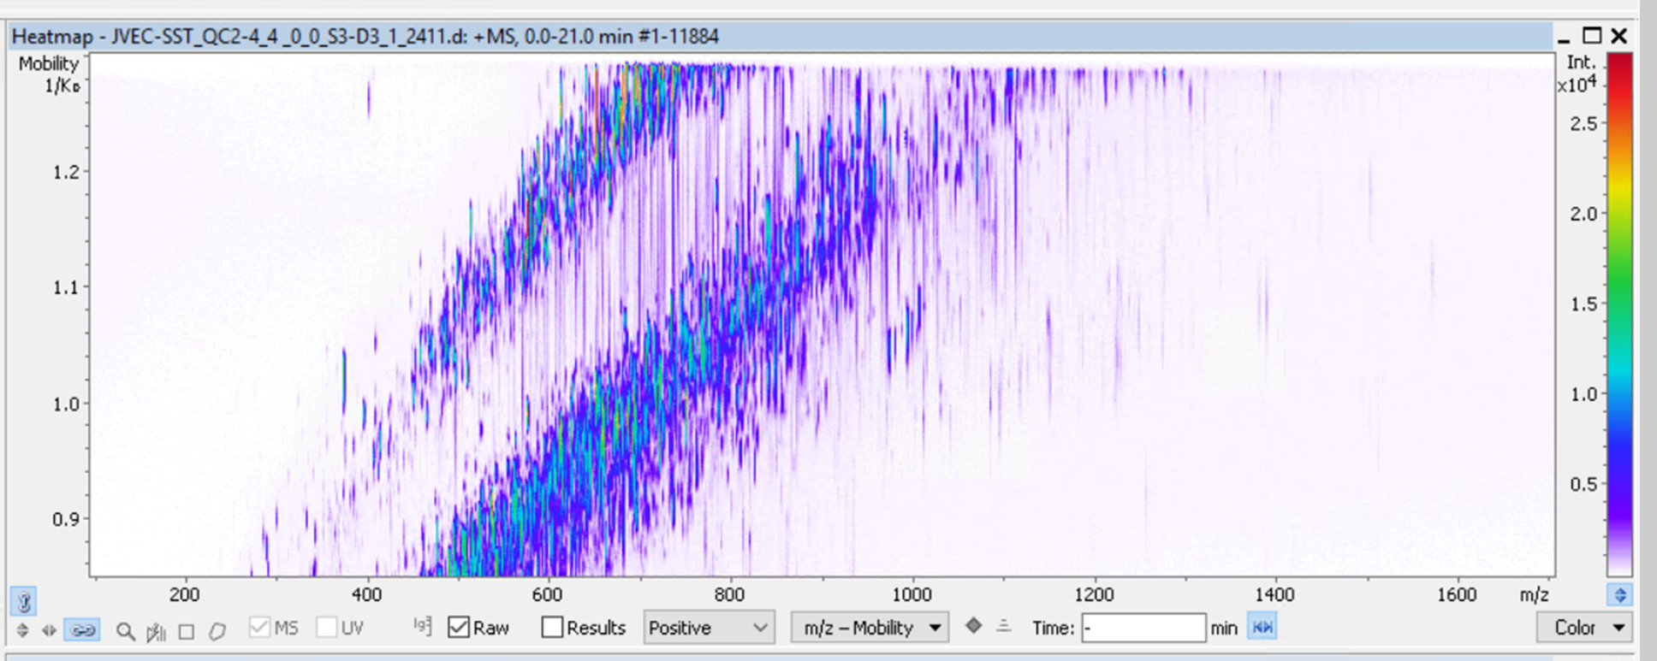
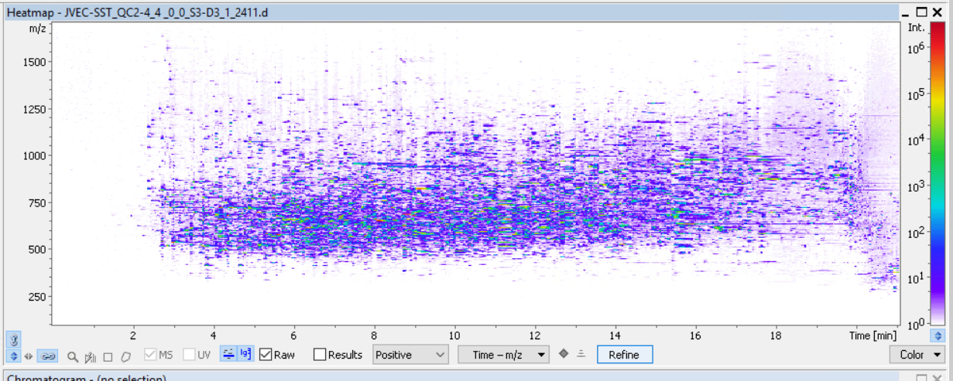
Trapped Ion Mobility Spectrometry Time-of-Flight Mass Spectrometry
(Tims-TOF)
Fast, reproducible and multi-dimensional
4-dimensional (4D) features tims TOF pro2
Intensity
Retention time
Ion mobility
Mass
Signal intensity
Time
Mobility (1/K_{o})
Samples description
From Deanna Plubell, Mike MacCoss Lab
m/z
Sample A. 100% HeLa
Sample B. 50% HeLa and 50% SILAC HeLa
Sample C. 10% HeLa and 90% SILAC HeLa
Sample D. 5% HeLa and 95% SILAC HeLa
Sample E. 100 % SILAC Hela
M/Z
Time
Notes:
trapped ion mobility spectrometry-time-of-flight mass spectrometry (TIMS-TOF)

Slide 3
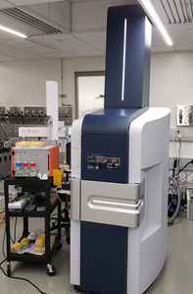
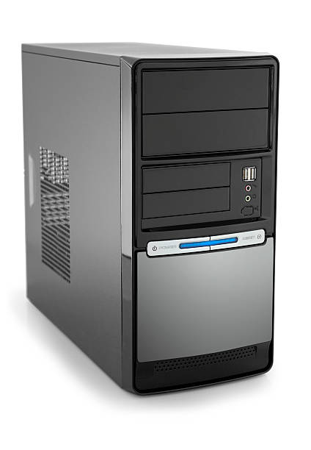
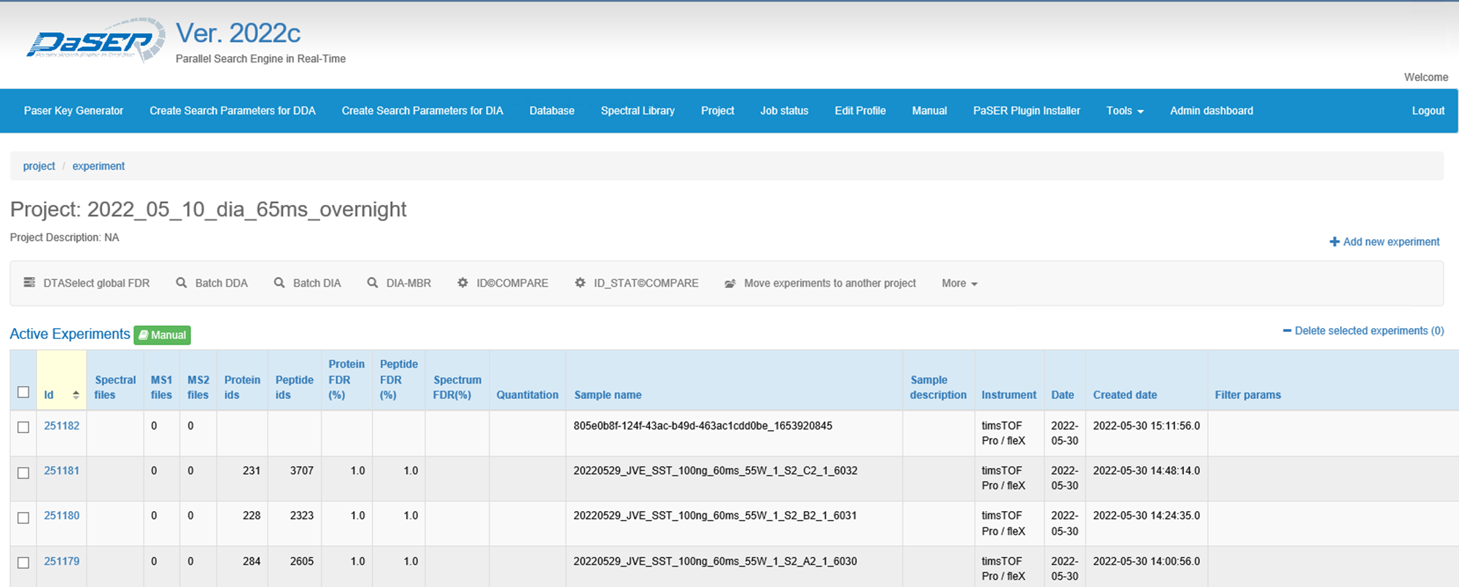

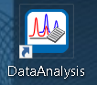
Real-time Search Results with PaSER
Real time
database search
Acquisition
Real time decision
Continue
Acquisition
or Stop
Peptide number, proteins number
(QCs, blanks and samples)
Data monitoring:
1. Real time search peptides number and proteins number
2. Intensity vs time (Retention time stability)
3. Mobility vs m/z
4. m/z vs time
5. mass accuracy
6. FWHM.Scans (full width at half maximum Scans, data point across the peak)

Slide 4
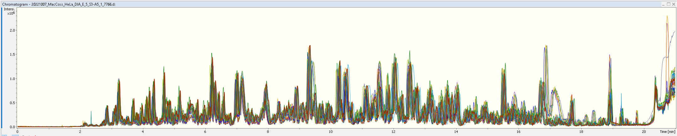
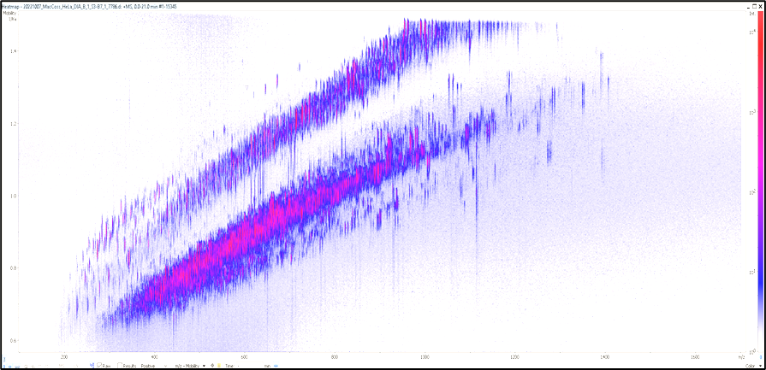
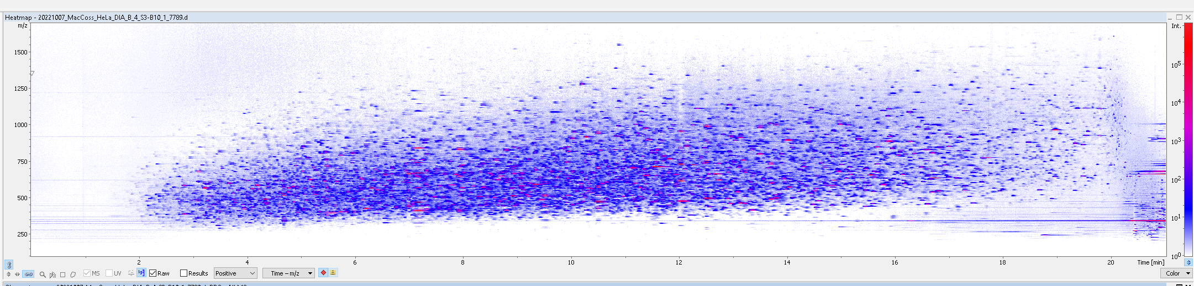
LC MS/MS Performance Monitoring
Intensity vs time (Chromatograms and retention time consistence-25 injections of Hela A to E)
Mobility vs m/z
m/z vs Time

Slide 5
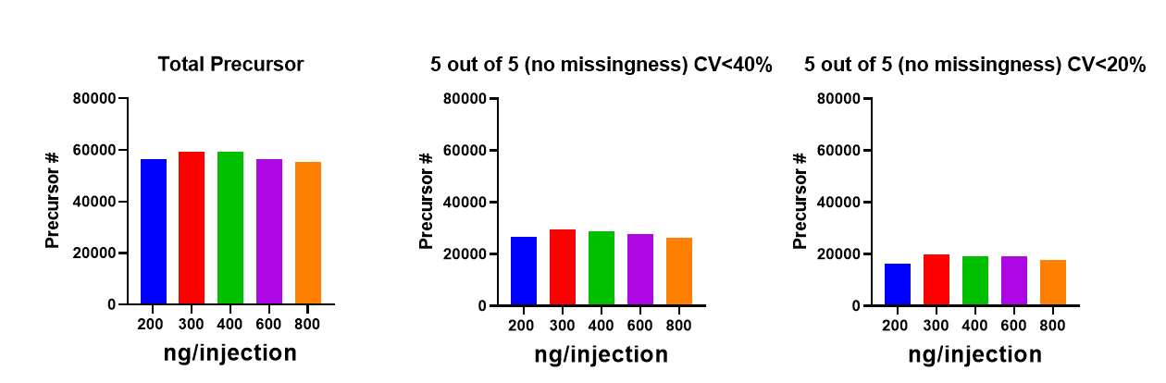
Loading Optimization
Total precursors vs reproducibility vs no missingness
Loading for the study
400 ng
No missingness and reproducibility

Slide 6
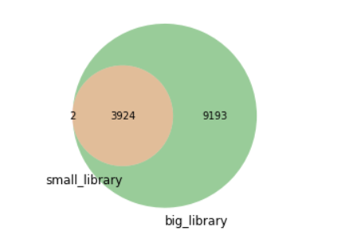
Library Generation
Method 1-10XDDA runs with Hela sample (A, 100% Hela), small library
Method 2-Combine 10xDDA runs library with Bruker’s human library, big library
 | Small Library | Big Library
Proteins | 3926 | 13117
Peptides | 26670 | 350788
Modified Peptides | 32246 | 516016
PrecursorIds | 37373 | 576624

Slide 7
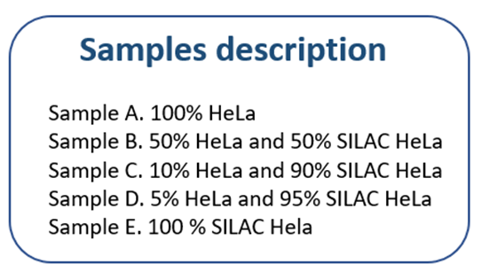
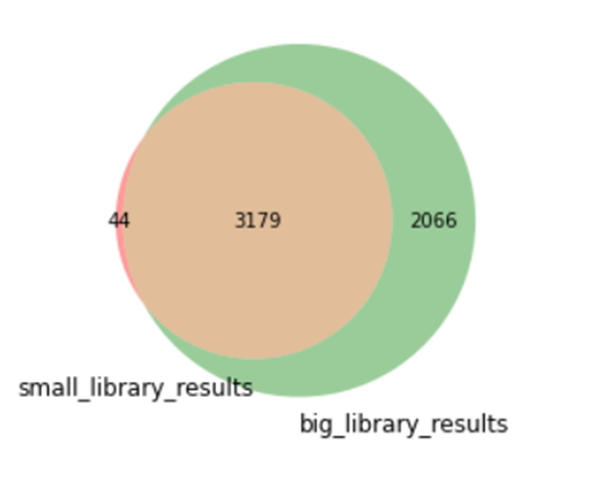
Search Results
Small Library- A, B, C, D, E group (5 injections) searched with Paser/Tims Diann
Big Library- A, B, C, D, E group (5 injections) searched with Paser/Tims Diann
Proteins
 | Small Library Results | Big Library Results
Proteins | 3223 | 5245
Peptides | 18689 | 28938
Modified Peptides | 21323 | 39701
Precursors | 23888 | 43091

Slide 8
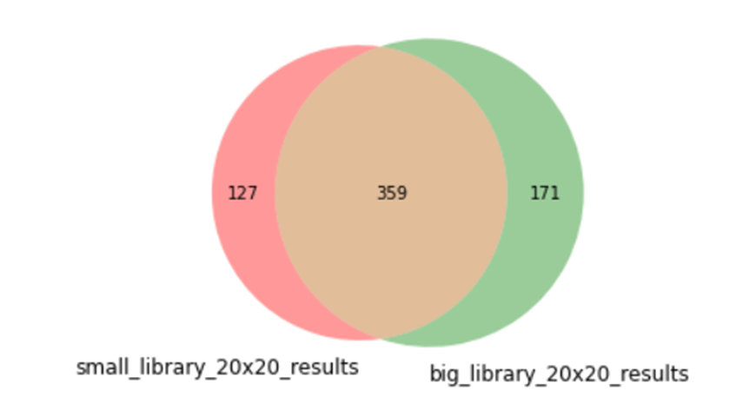
Narrow Search Results with Filters
Filter criteria:
Present in A, B, C, D groups
Present in all injections (no missingness, 20 out of 20 injections)
CV<20% within the group (from 5 injections)
Sample groups: A (100%), B (50%), C (10%) and D (5%)
Proteins
 | Small Library Results | Big Library Results
Proteins | 486 | 530
Peptides | 1096 | 1130
Modified Peptides | 1146 | 1301
Precursors | 1182 | 1334

Slide 9
Lower limit of Quantification
Undiluted Analytes pool
2-5-fold dilutions with analyte-free matrix
N= 5 of each level
Performed twice
Until analyte no longer quantifiable
CV and Bias (~recovery) compared to expected values
Grant and Hoofnagle, Clin Chem 2014

Slide 10
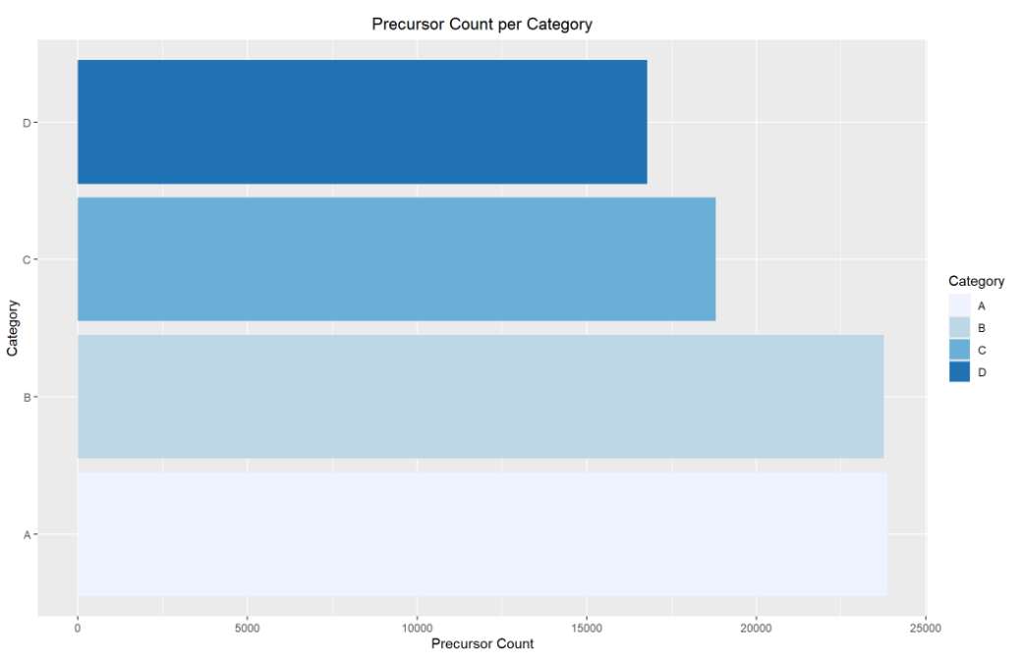
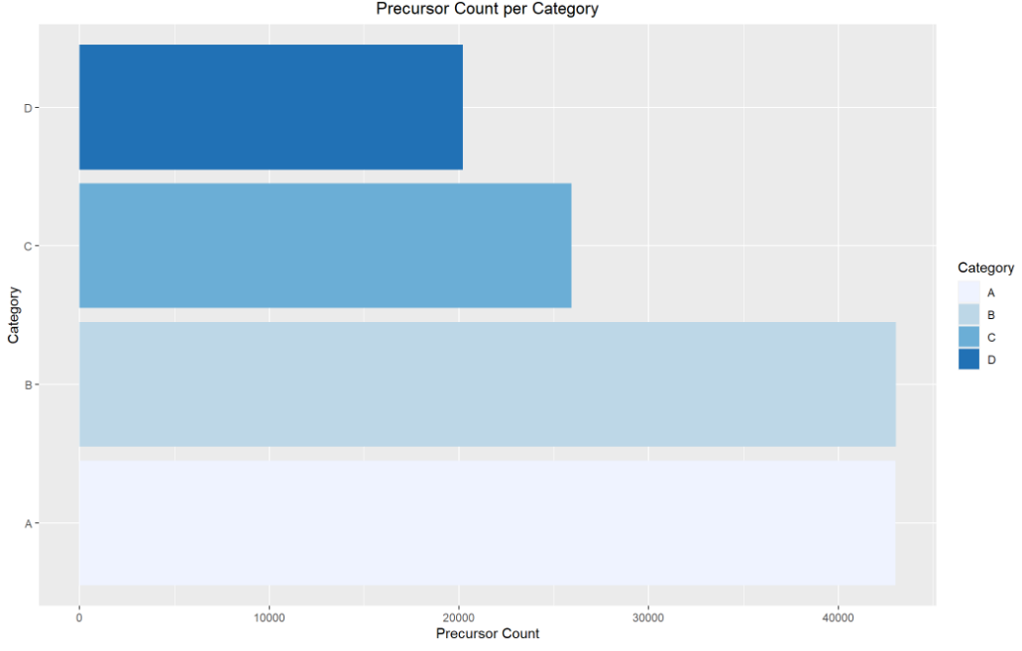
Demo: Count Number of Precursors per Concentration Category
Small Library
Large Library
The larger library shows higher number of precursors across each category

Slide 11
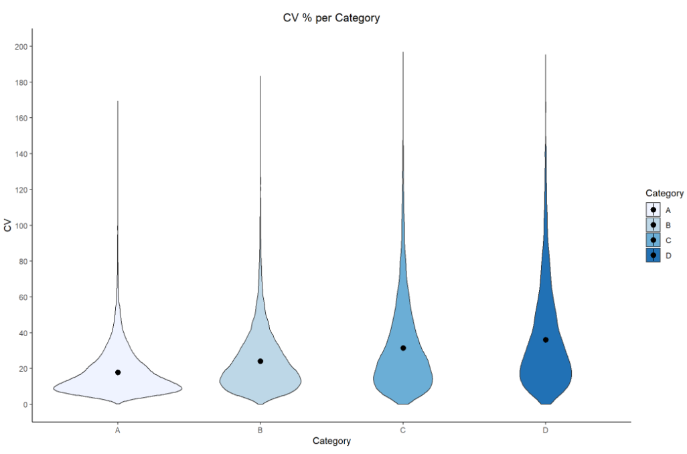
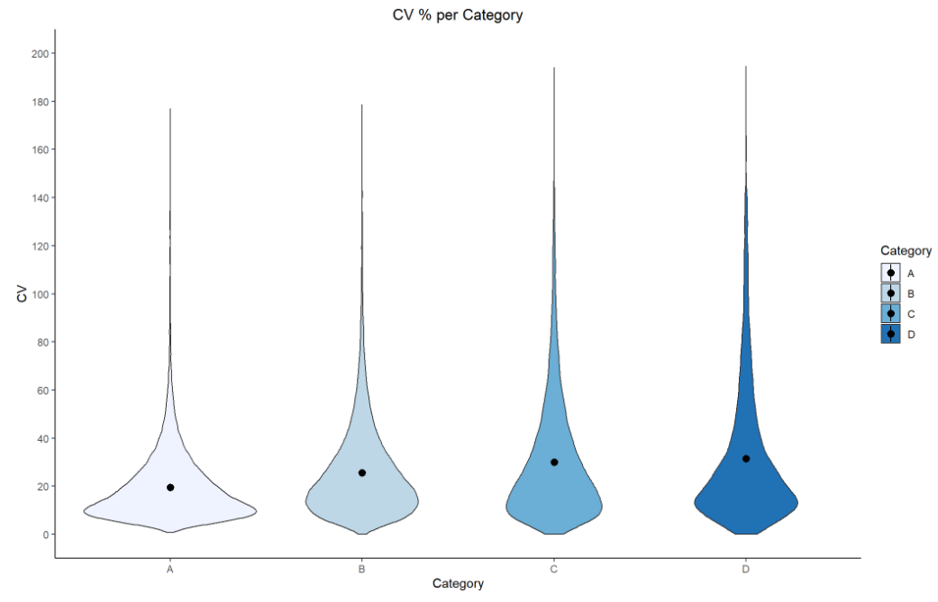
Demo: CV Calculation Across Injections within each Concentration Category
Small Library
Large Library
In both cases, higher concentrations of Hela (left: A) shows the lowest CVs, with gradual increase in CV as concentration decreases.

Slide 12
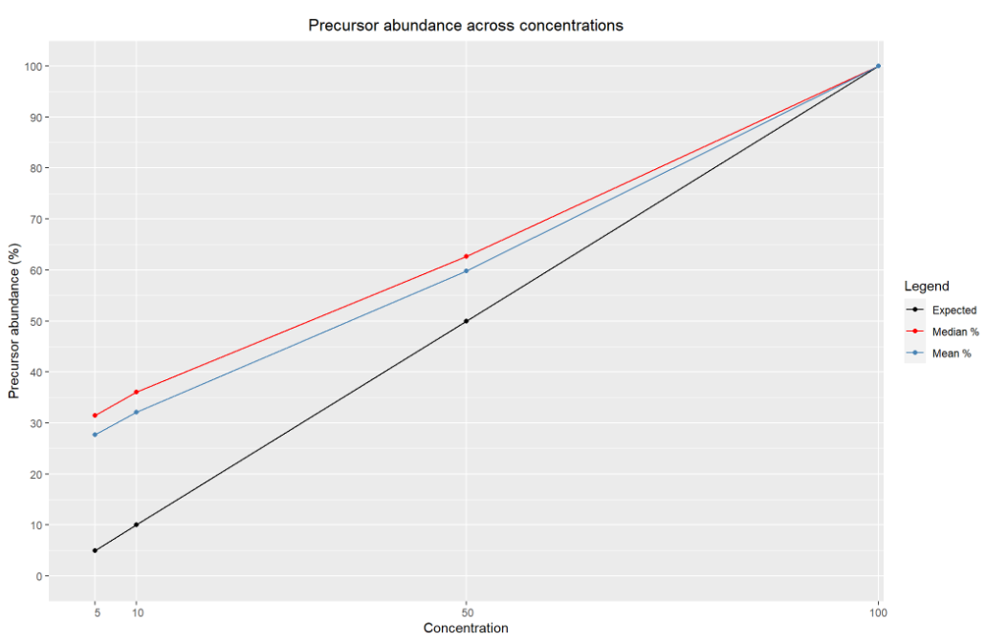
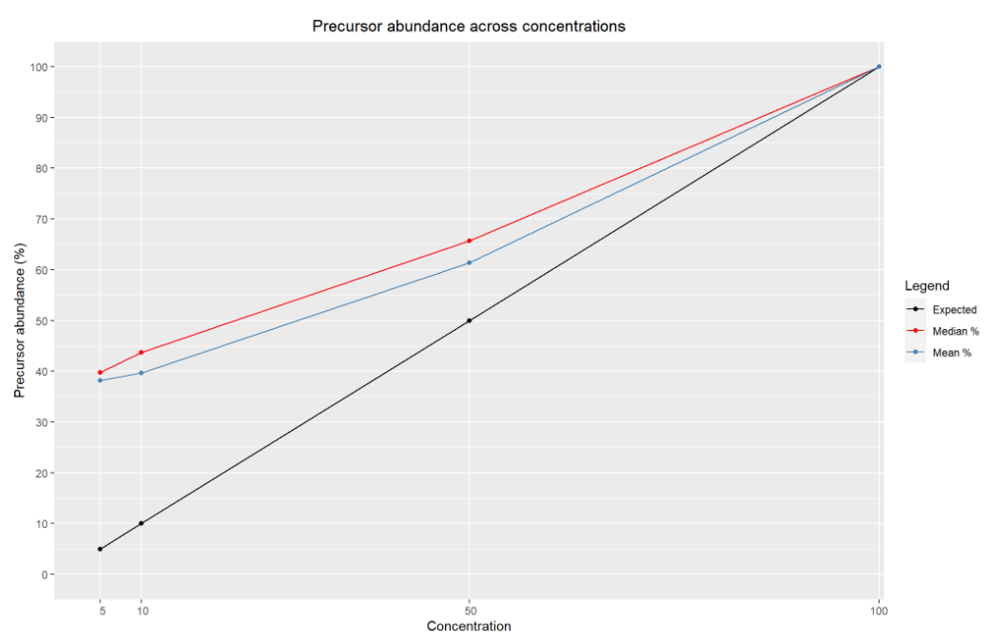
Demo: Precursor Abundance across Concentration Categories
Small Library
Large Library
Even though the big library shows higher number of precursors and proteins, the smaller library shows tighter trends towards the expected patterns.

Slide 13
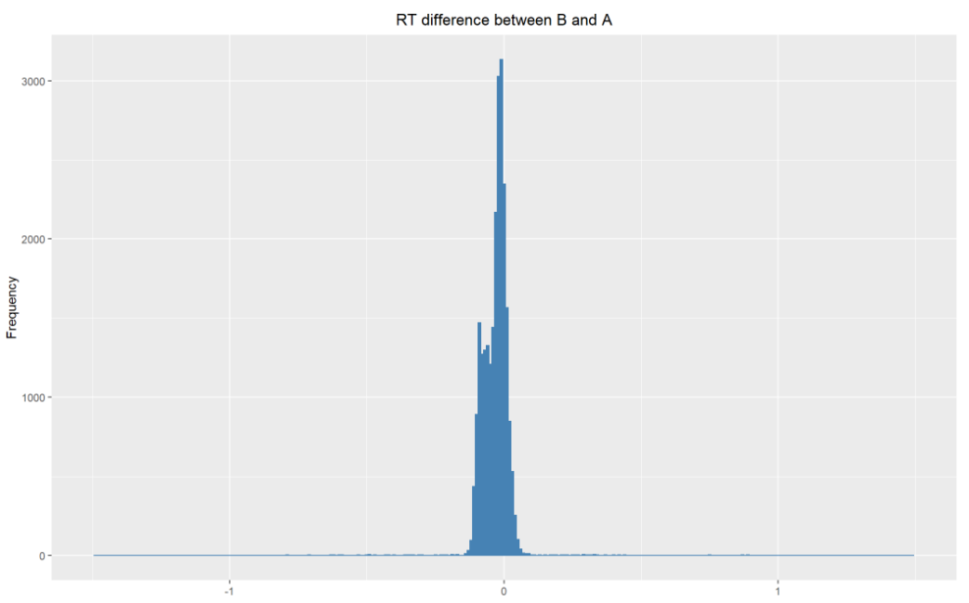
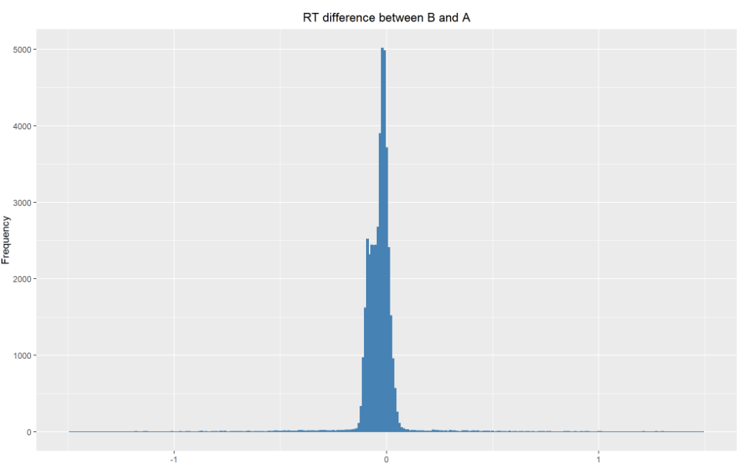
Demo: RT Difference between Precursors
Small Library
Large Library
RT difference between common precursors across the concentration categories indicates that the difference window is slightly narrower in the case of the small library

Slide 14
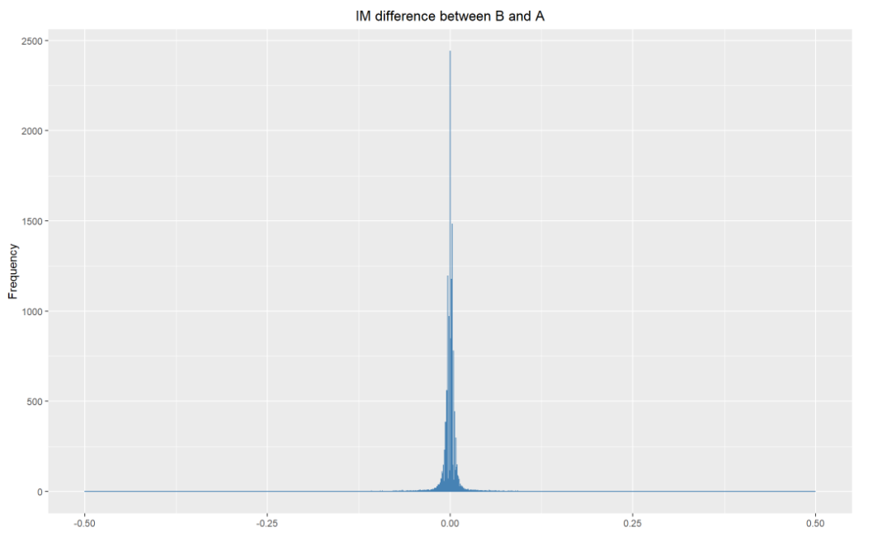
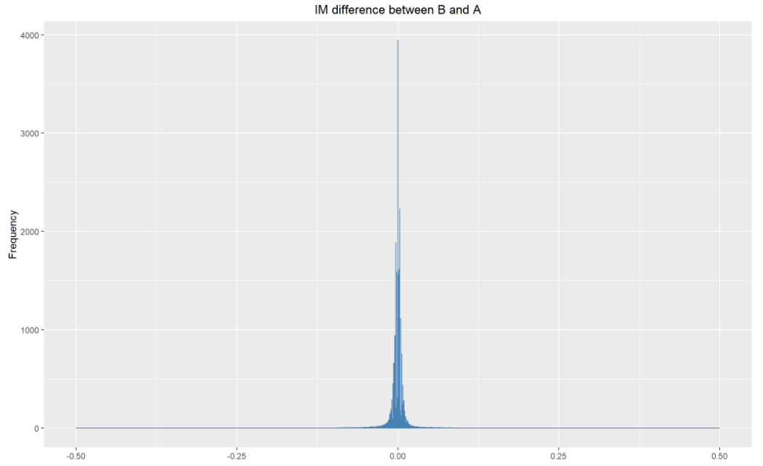
Demo: Ion Mobility(IM) Difference between Precursors
Small Library
Large Library
IM difference between common precursors across the concentration categories

Slide 15
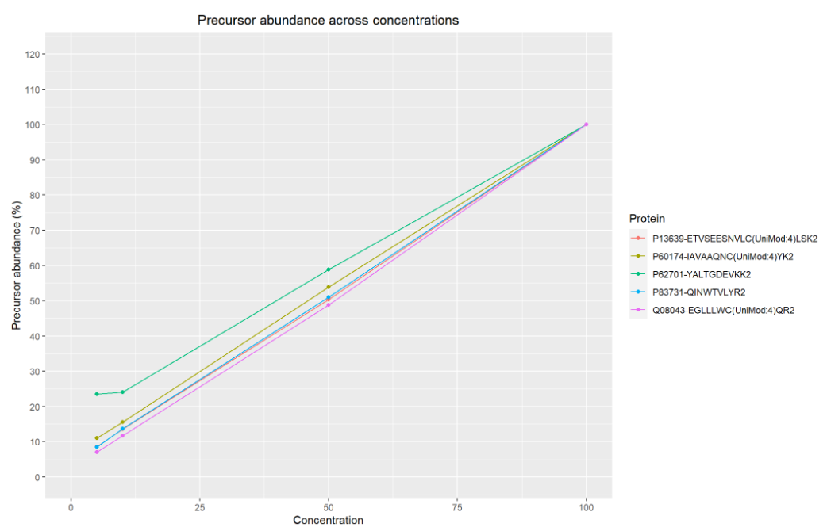
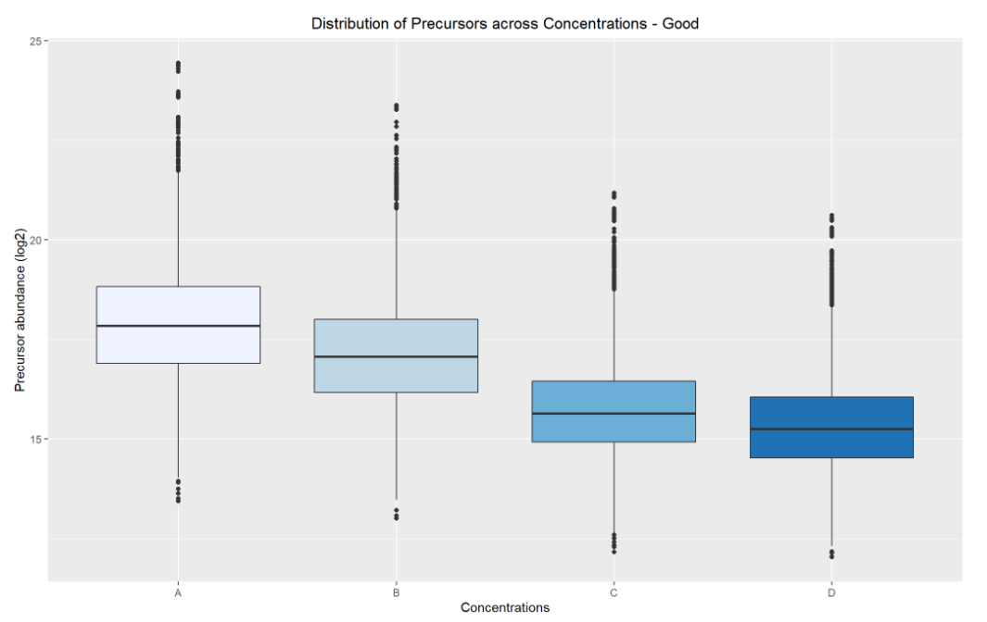
Demo: Precursors with Good Regression
Good:
Precursors with CV < 20% and no missingness
Correlation b/w measured and expected trend >= 0.9

Slide 16
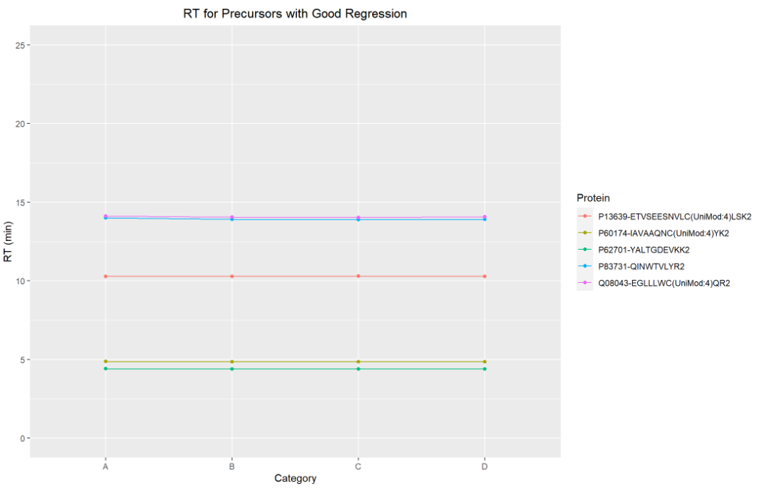
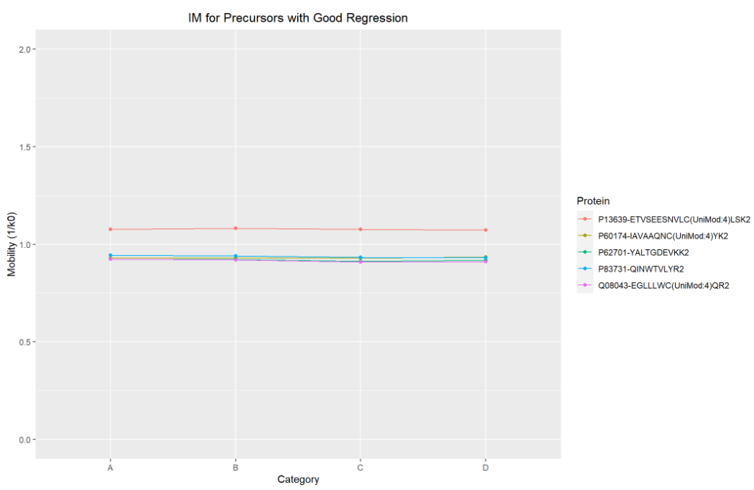
Demo: Precursors with Good Regression

Slide 17
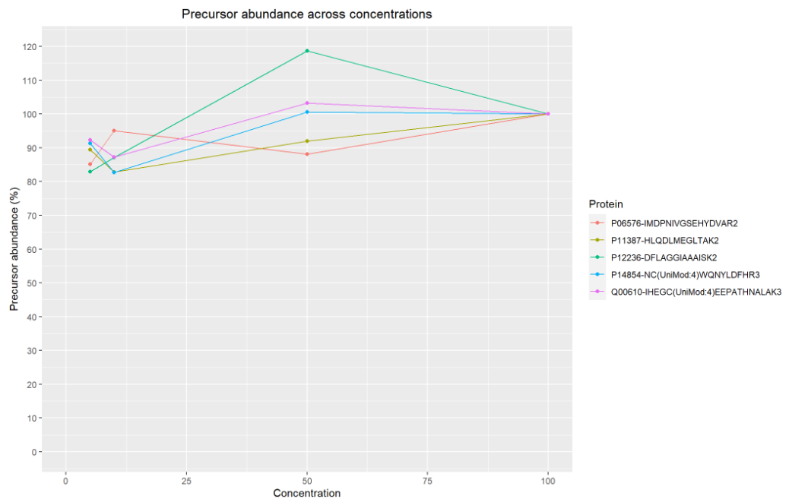
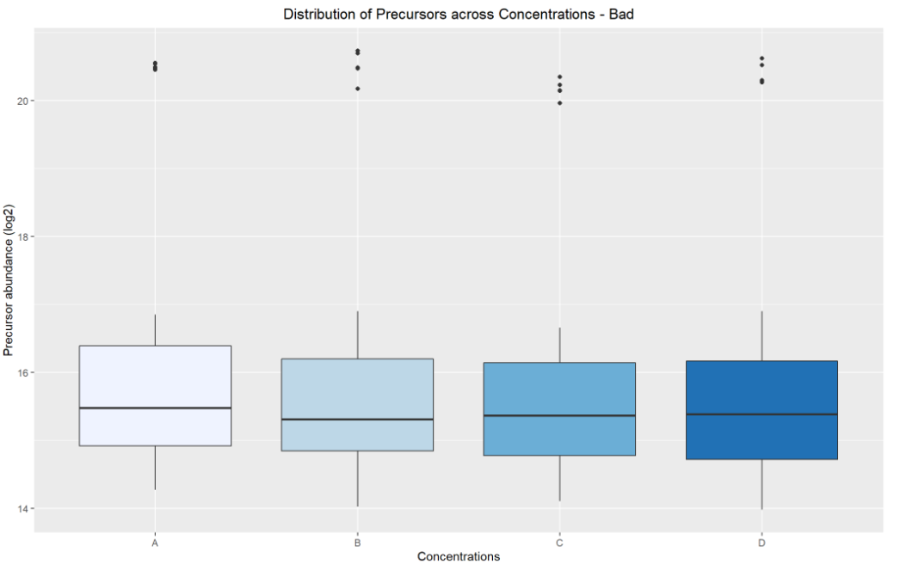
Demo: Precursors with Bad Regression
Bad:
Precursors with CV < 20% and no missingness
Correlation b/w measured and expected trend b/w 0.5 – 0.7

Slide 18
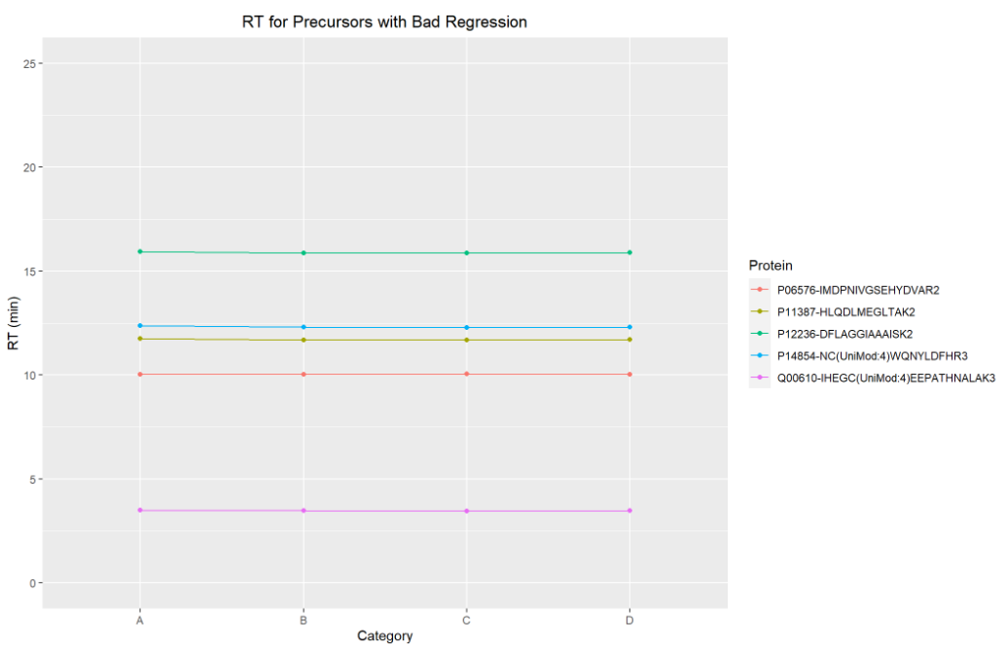
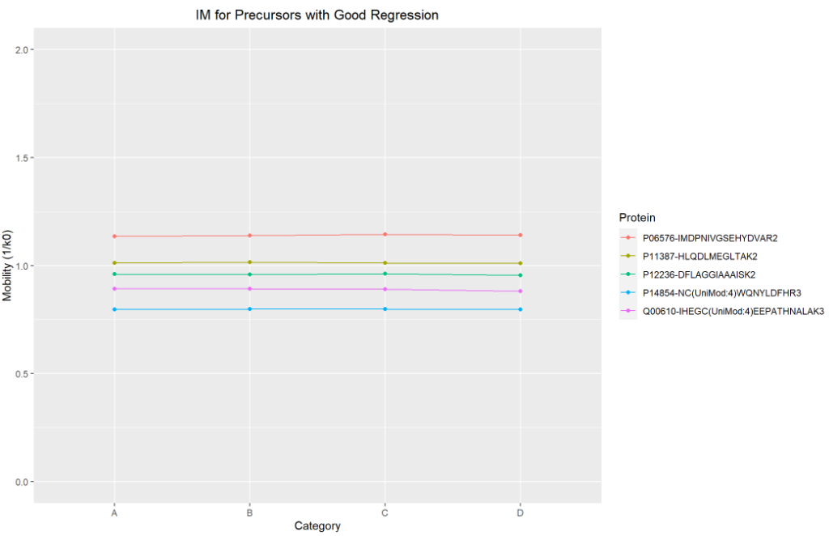
Demo: Precursors with Bad Regression

Slide 19
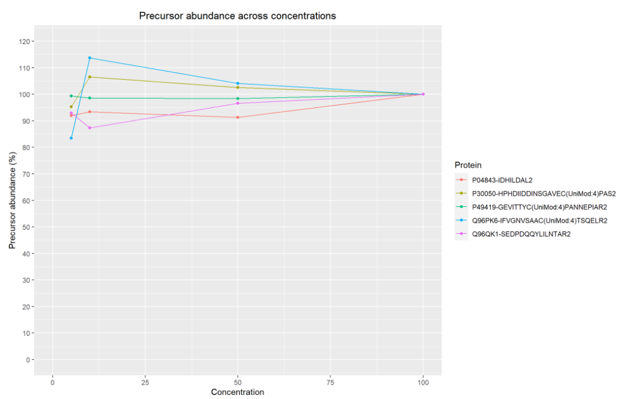
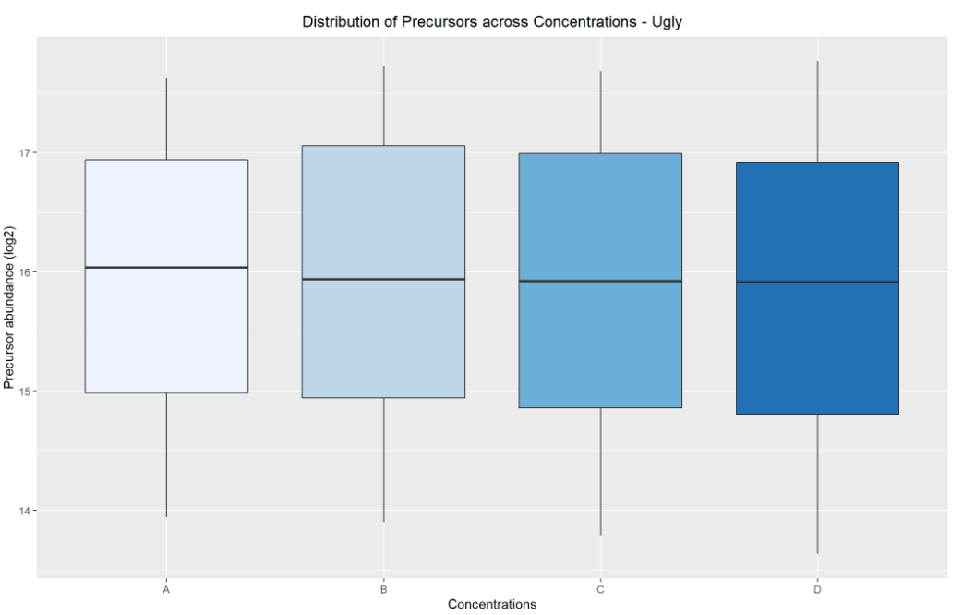
Demo: Precursors with Ugly Regression
Ugly:
Precursors with CV < 20% and no missingness
Correlation b/w measured and expected trend <= 0.4

Slide 20
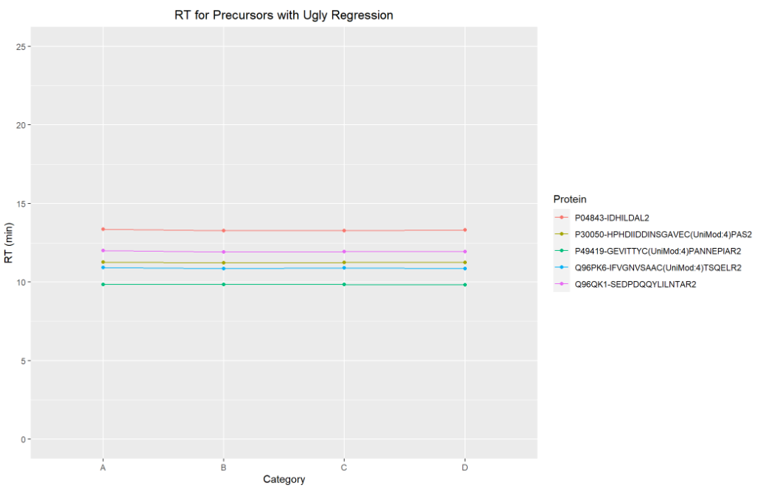
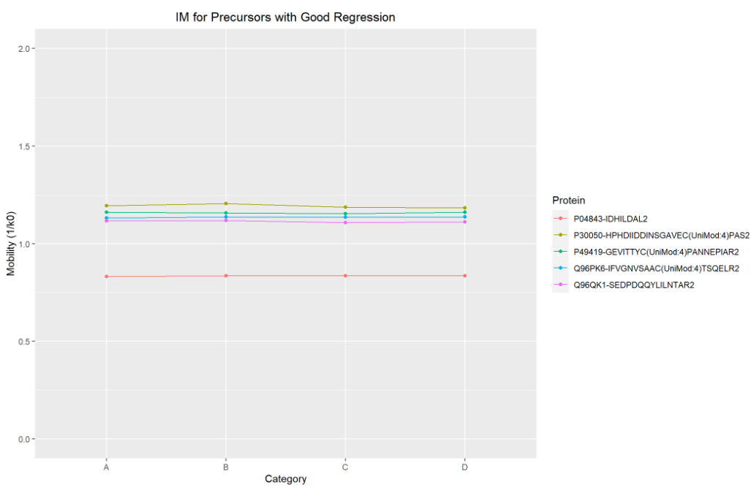
Demo: Precursors with Ugly Regression

Slide 21
Conclusions
Large library has more precursors and proteins compared to small library
Search results also yield the same trend when comparing large library to small library
CV trends indicate that the higher concentrations of Hela have smaller variations across injections whereas lower concentrations show higher variations.
Larger does not always mean better i.e., search via the large library yields higher number of precursors but the quantifiable precursors (based on linearity) of the search using the smaller library is closer to expected trend.

Slide 22
Access to Input Files/Scripts/Results
Instructions for Downloads/Setup Required before ASMS Workshop located on GitHub Link:
https://github.com/csmc-vaneykjlab/ASMS-Workshop-TimsTOF-Analysis
Link to Input Files, Results, Script for visualization and Setup Guidelines provided.

Slide 23
Acknowledgements
ACBRI/Jenny Van Eyk Lab
Bruker
Ajay Bharadwaj
Aleksandr Stotland
Aleksandra Binek
Ali Haghani
Archana Bhat
Blandine Chazarin
Christopher I Murray
Kirstin E Washington
Koen Raedschelders
Lindsey Becker
Matthew Ayres
Maxim Zhgamadze
Mitra Mastali
Oleg Karpov
Rakhi Pandey
Saeed Seyedmohammad
Manasa Vegesna
Qin Fu
Simion Kreimer
Christopher Adams
Robin Park
Michael Krawitzky
Tharan Srikumar
Jonathan Krieger
Tomasz Siwarga
Stephanie Kaspar-Schoenefeld

